Slide 1
Team Building & Project Management
UNIT-V

Slide 2
Team Building & Project Management
Leadership Styles,
Shared Leadership Model
Team Building in Venture
Role of good team in venture, Roles and Respondents
Explore collaboration tools and techniques- Brainstorming, Mind mapping.
Importance of Project Management, Time Management, Workflow,
Network Analysis Techniques – Critical Path Method, Project Evaluation Review Technique and Gantt chart.

Slide 3
Leadership Style
A leadership style refers to a leader's characteristic behaviors when directing, motivating, guiding, and managing groups of people.
Great leaders can inspire political movements and social change. They can also motivate others to perform, create, and innovate.
Leadership style is the manner and approach of providing direction, implementing plans, and motivating people.
It includes the total pattern of explicit and implicit actions performed by their leader (Newstrom, Davis, 1993).
The first major study of leadership styles was performed in 1939 by Kurt Lewin who led a group of researchers to identify different styles of leadership

Slide 4
Types of Leadership Style
Authoritarian or Autocratic - the leader tells his or her employees what to do and how to do it, without getting their advice.
Participative or Democratic - the leader includes one or more employees in the decision making process, but the leader normally maintains the final decision making authority.
Delegative or Laissez-fair (free-rein) - the leader allows the employees to make the decisions, however, the leader is still responsible for the decisions that are made

Slide 5
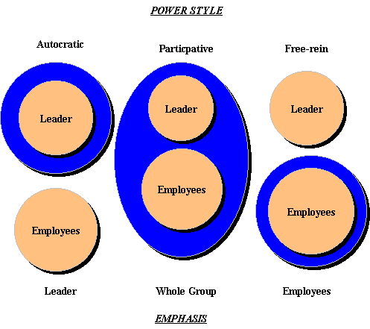

Slide 6
Shared Leadership
Shared leadership is a leadership style that broadly distributes leadership responsibility, such that people within a team and organization lead each other.
It has frequently been compared to horizontal leadership, distributed leadership, and collective leadership.
Definition:
A systematic approach of finding and developing organizational leaders
These leaders take important areas, products and services
They lead and develop cross-functional teams
Every team focuses on smaller big part of the organization portfolio.

Slide 7
Reasons to implement Shared leadership
The act of sharing leadership promotes innovative and committed behavior among team members;
Shared leadership positively transforms the composition of vertical companies, reintegrating teams;
Individuals at the firm create bonds of interdependence through the exercise of shared leadership, favoring teamwork;
Freedom and the ability to speak out during the execution of shared activities increases levels of satisfaction and company identification among its members;
Example of positive behavior and the proactively of shared leadership affects everyone within the company, broadly motivating teams;
Successful results that are achieved through shared leadership lead to a recognition of the participative nature of each employee’s contribution to that success, causing teams to actively desire growth for the company.

Slide 8
How shared leadership can benefit companies and partnerships
In addition to its association with innovation, the growing prevalence of team-based work favors the adoption of shared leadership, which is why work in groups is prevalent in this model.
Shared leadership and partnerships between leaders bring along with them a number of changes to the workplace and the composition of teams.
When leaders understand that most employees are just seeking some space and a measure of recognition,
It is easy to understand how shared leadership can motivate staff, elevating both team performance and the company’s results.

Slide 9
Team Building Defined
Team building is the process of taking a collection of individuals with different needs, backgrounds and expertise and transforming them by various methods into an integrated, effective work unit.
The concept of team building becomes critically important as bureaucratic hierarchies decline and horizontally-oriented teams and work units become increasingly important.
In most cases, team building involves relationships among peers with a wide diversity of expertise.

Slide 10
Major Barriers To Project Team Development
Differing Outlooks, Priorities, Interests and Judgments of Team Members
Role conflicts
Project Outcomes Not Clear
Competition Over Team Leadership
Lack of Team Definition and structure
Team Personnel Selection
Credibility of the Project Leader
Lack of Team Member Commitment

Slide 11
Role of good team in venture, Roles and Respondents
A great Top Team extends the values, vision, mission and plan throughout the company, aligns the company and accelerates its growth.
A dysfunctional team can tear a company apart and send it down the tubes.
This team should consist of people who can manage three significant roles: functional, executive, and leadership.
Team members must be able to combine managing operations, serving on your executive team and helping you fulfill some of your leadership roles and responsibilities.

Slide 12
The Evolution of the Top Team
An effective Top Team must be able to run the company day to day in order to be able to move out of operations and focus on strategy.
Top Team can help create a new and better "big-picture" vision as the company grows. They'll bring a new perspectives and specialized knowledge.
Encourage and support them as they grow and develop into their expanded roles and responsibilities.

Slide 13
The team responsible for implementing the company's plan, measuring and evaluating results, and helping each other succeed.
Hold them accountable for their performance in all three areas detailed above.
Be explicit and define the expectations of each Top Team member.
Be clear about which roles and tasks we are retaining and which ones we are delegating to them individually and as a group. Provide direction to them.

Slide 14
The Roles and Responsibilities of the Top Team
When you assemble your Top Team, each member must be capable of fulfilling all of the following roles and responsibilities:
As the leader of their functional area, team members must:
Manage their functional area(s) and the resources allocated to them.
Attract and retain great people.
Communicate effectively so that everyone in their unit understands the company's vision, mission, values, and plan; how their job relates to the plan, and the results expected of them.

Slide 15
As a member of the Executive Team, team members must:
Manage the implementation of the company's plan.
Be a role model for innovation, teamwork, and problem-solving.
Help other team members succeed.
As a member of your Leadership Team, team members must:
Help you develop the plan for growth.
Protect and build a company culture that supports growth.
Optimize resources to achieve company goals.

Slide 16
Explore Collaboration Tools and Techniques
Mind Mapping
Brainstorming
Thinking Hats Method
Nominal Group Technique
Fish-bone Diagram

Slide 17
1. Mind Mapping
The key to mind mapping is to take note of every idea that comes up.
We should not neglect anything, no matter how far-fetched it may seem.
Generate as many ideas as possible; the more we get, the bigger chance of finding that golden ticket idea.
Mind maps capture thoughts, ideas and keywords ,we can organize them in a two-dimensional structure.
The title/main idea is always located in the center of the map and thus always clearly visible.
Related ideas branch off from the center in all directions, creating a radiant structure.

Slide 18
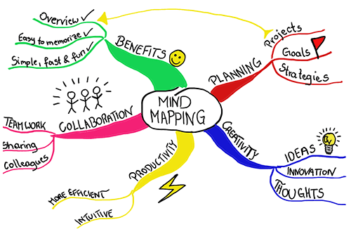

Slide 19
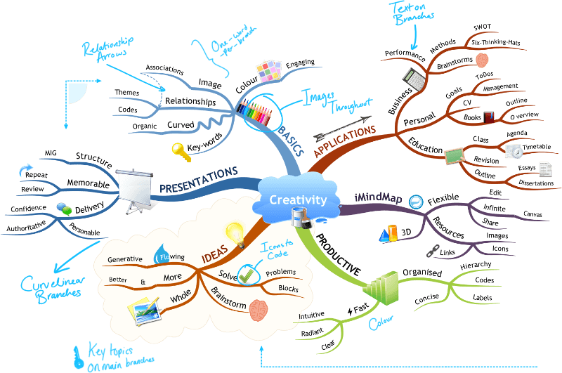

Slide 20
Mind Mapping Does
Improves productivity
Structures information
Finds relationship between variables
Fosters creativity
Improves memory and recall

Slide 21
2 . BRAINSTORMING
Alex F.Osborn employed Brainstorming to generate ideas.
It is a technique for finding alternatives which can be used at all stages of Problem-solving process.
It is entirely a divergent thinking process.

Slide 22
Osborn laid down four guidelines
Criticism is ruled out:
Negative comments on ideas must be discouraged to allow for free exploration of all ideas.
Free wheeling is welcomed:
Freewheeling is encouraged with any ideas welcomed as it is easier to later refine ideas than to make them more unique.
Quantity is encouraged
The greater the number of ideas The more likelihood of useful ideas
Combining & improving ideas is encouraged
Participants should suggest how the ideas of others could be joined into a still newer ideas to get the best solution.

Slide 23
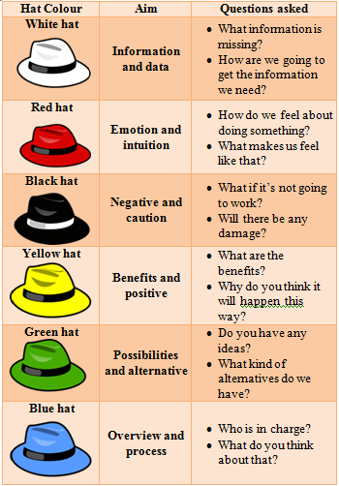
3.Thinking Hats Method
This tool was created by Edward de Bono in his book ' 6 Thinking Hats ‘ in the year 1986.
At any moment everyone is looking in the same direction.
Each thinker puts forward his or her thoughts in parallel with the thoughts of others
Guides thought processes in one direction at a time so we can effectively analyze issues, generate new ideas, and make better decisions

Slide 24
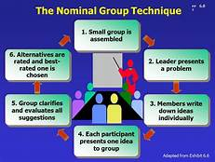
4. Nominal Group Technique
This technique was originally developed by Andre Delbecq and Andrew H. Van de Ven
A systematic and an organized group meeting held among the members to facilitate decision making by properly identifying the problems and generating the solutions thereof.

Slide 25
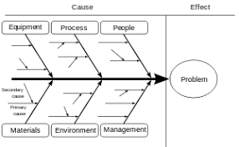
5.Fishbone Technique
Dr. Kaoru Ishikawa, a Japanese quality control statistician, invented the fishbone diagram.
A cause-and-effect analysis generates and sorts hypotheses about possible causes of problems within a process by asking participants to list all of the possible causes and effects for the identified problem

Slide 26

PROJECT
“A project is a series of activities or tasks or operations directed to accomplishment of a desired objective.”
“A project is a temporary Endeavour undertaken to create a "unique" product or service.”

Slide 27
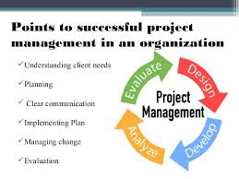

Slide 28
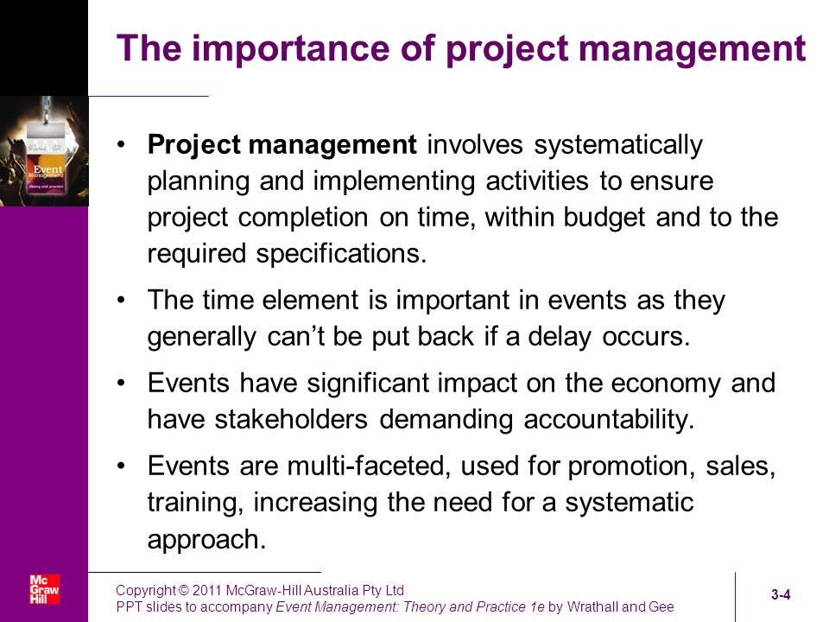

Slide 29
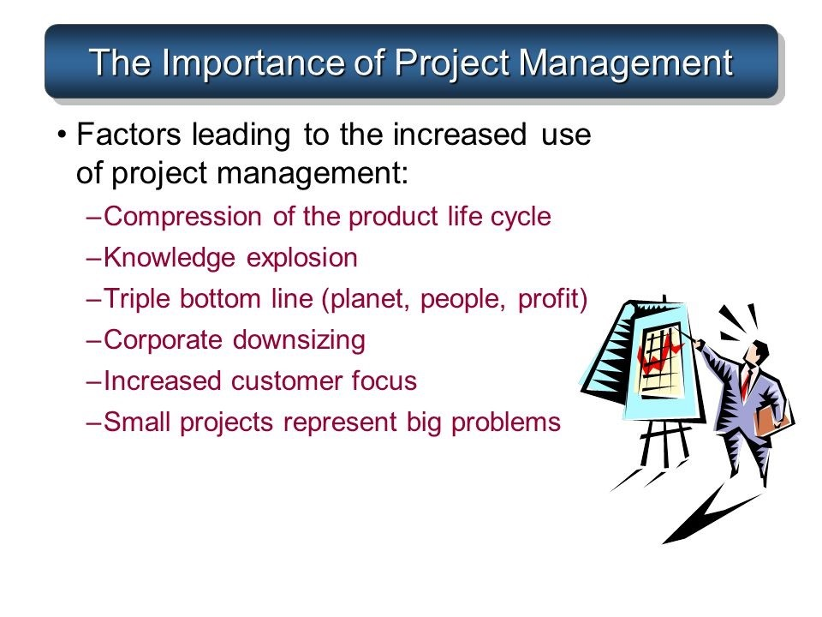

Slide 30
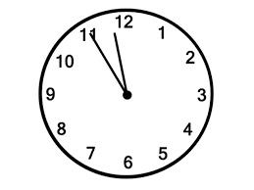
Time Management
Time Management is the process of planning and exercising conscious control of time spent on specific activities, especially to increase effectiveness, efficiency and productivity.

Slide 31
The major themes arising from the literature on time management include the following:
Creating an environment conducive to effectiveness
Setting of priorities
Carrying out activity around prioritization.
The related process of reduction of time spent on non-priorities
Incentives to modify behavior to ensure compliance with time-related deadlines.

Slide 32
Time management is related to different concepts such as:
Project Management: Time management can be considered to be a project management subset and is more commonly known as project planning and project scheduling.
Time management has also been identified as one of the core functions identified in project management.
Attention Management relates to the management of cognitive resources, and in particular the time that humans allocate their mind (and organize the minds of their employees) to conduct some activities.

Slide 33
Organizational time management is the science of identifying, valuing and reducing time cost wastage within organizations.
It identifies, reports and financially values sustainable time, wasted time and effective time within an organization.
Develops the business case to convert wasted time into productive time through the funding of products, services, projects or initiatives at a positive return on investment.

Slide 34
WORK FLOW
Workflow is the definition, execution and automation of business processes where tasks, information or documents are passed from one participant to another for action, according to a set of procedural rules.
Organizations use workflows to coordinate tasks between people and synchronize data between systems, with the ultimate goal of improving organizational efficiency, responsiveness and profitability.

Slide 35
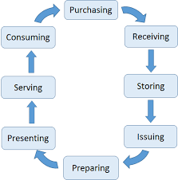
A fully functional workflow provides four key benefits to a company:
✓ Improved productivity
✓ Process transparency
✓ Faster business reaction time
✓ Improved accountability

Slide 36
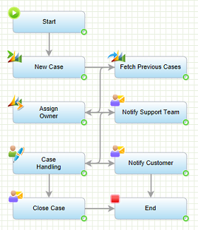
Customer Support Case

Slide 37
EARLY TECHNIQUES OF PROJECT MANAGEMENT
A Gantt chart is a type of bar chart that illustrates a project schedule, named after its inventor, Henry Gantt (1861–1919), who designed such a chart around the years 1910–1915.
Modern Gantt charts also show the dependency relationships between activities and current schedule status.

Slide 38
A Gantt chart is a type of bar chart that illustrates a project schedule.
This chart lists the tasks to be performed on the vertical axis, and time intervals on the horizontal axis.
The width of the horizontal bars in the graph shows the duration of each activity.
Gantt charts illustrate the start and finish dates of the terminal elements and summary elements of a project. Terminal elements and summary elements constitute the work breakdown structure of the project.
Modern Gantt charts also show the dependency (i.e., precedence network) relationships between activities.
Gantt charts can be used to show current schedule status using percent-complete shadings and a vertical "TODAY" line as shown here.

Slide 39
NETWORK ANALYSIS
According to author – “Network analysis helps to designing, Planning, Coordinating and decision making in order to accomplish the project economically in the minimum available time with the limited available resources.”

Slide 40
Network analysis is a system which plans projects both large and small by analyzing the project activities
Projects are broken down to individual tasks or activities, which are arranged in logical sequential order
A network diagram is constructed which presents the relationship b/w all the activities involved.

Slide 41
NETWORK ANALYSIS TECHNIQUES
Network Analysis refers to a number of techniques for the planning and control of complex projects.
The two most frequently used forms of network planning are:
1. Programme Evaluation and Review Technique (PERT)
2. Critical Path Method (CPM)

Slide 42
